Slide 1
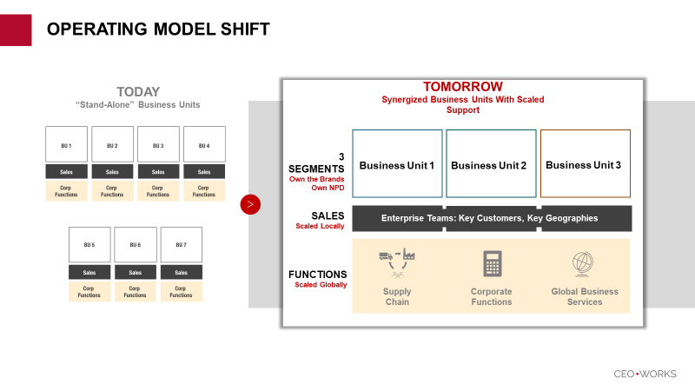
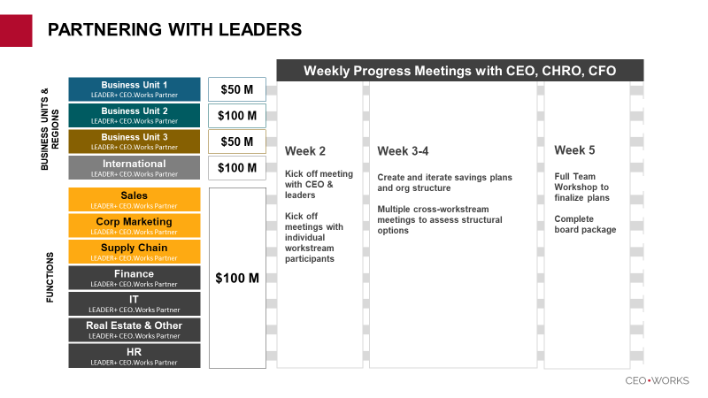
Organizational Efficiency: Process & Design
SAMPLE CPG COMPANY CASE: Together with the CEO and other key leaders selected for roles in the future organization, FulcrumQ guided the creation of a new operating model to drive the value ambition. By challenging status quo, ensuring strong adherence to the co-created design principles (aligned to value creation), and surfacing inconsistencies in the future design, FulcrumQ helped the client create a future state plan that had high internal confidence and was board-ready.
1
FulcrumQ Set Foundational Alignment with CEO
2
Executives and FulcrumQ Co-Created Savings Plan
3
Discovery
1-on-1 meetings with divisional and functional leaders
ALIGNMENT:
Value Agenda
Design Principles
Current (#) | Future (#) | Reduction (%)
9250 | 7775 | 16%
$236M in Potential Savings
Underpinned by 79 Critical Roles Identified & Prioritized for Value protection & generation

